Slide 1
Microprocessor
It is brain of computer
It is a single chip which is capable of processing data.
It controls all the components in computer .eg monitor,keyboard,usb etc
It fetch,decode and execute the instruction

Slide 2
Defination
A microprocessor is a programmable electronic chips that has computing and decision making capacity similar to central processing unit of computer

Slide 3
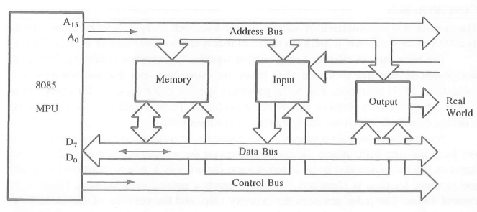
Bus organization of 8085
Bus is a group of conducting wires which carries information all the peripheral are connected to microprocessor through Bus.

Slide 4
Address Bus
Is a group of conducting wires which carries address/particular location only.
It is unidirectional only ie data flows from microprocessor to memory or from microprocessor to i/o device.
Length of address bus is 16 bit(0000H to FFFFH)
It can transfer maxmimum 16bit address which means it can address 65536 different memory location.

Slide 5
Data Bus
Conducting wire carries data only.
Bidirectional because data flow in both direction from microprocessor to memory or i/o device.
Length of data bus of 8085 is 8bit (00H to FFH)
The width of data bus is directly related to the largest number that bus can carry such as 8 bit bus can represent 2^8 (0-255)

Slide 6
Control bus
Use to generate timing and control signal to control all associated peripherals.
Uses control signal to process data that is what to do with selected memory location. Some control signal are
Memory read
Memory write
i/o read
i/o write
Opcode fetch

Slide 7
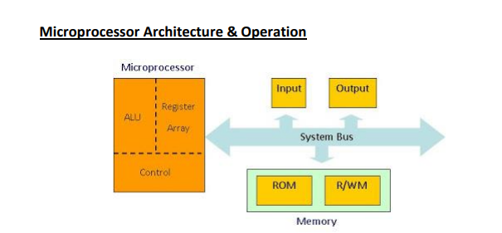

Slide 8
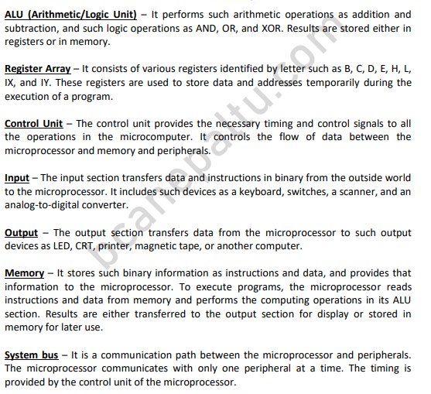

Slide 9
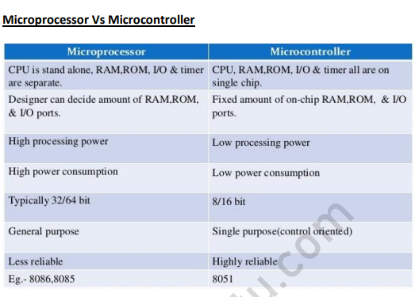

Slide 10
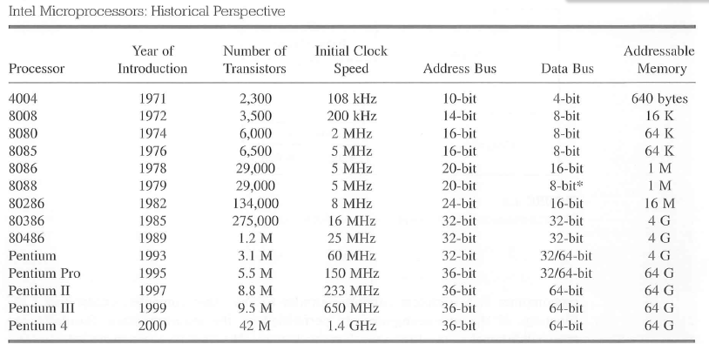
Processor overview

Slide 11
8085 instruction set
Classified into five functional categories:
Data transfer(Copy) operation
Arithmetic operation
Logical operation
Branching operation
Machine control operation

Slide 12
Data transfer(copy) operation
Copies data from a location called source to another location called Destination without modifying the content of source.
The various types of data transfer are:
Between register
Specific data byte to register
Between memory location and a register
Between i/o device and accumulator

Slide 13
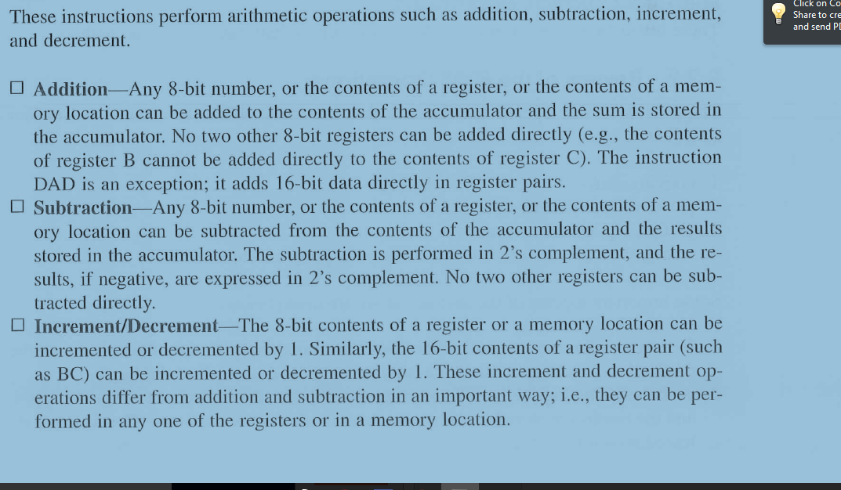
Arithmetic Operation

Slide 14
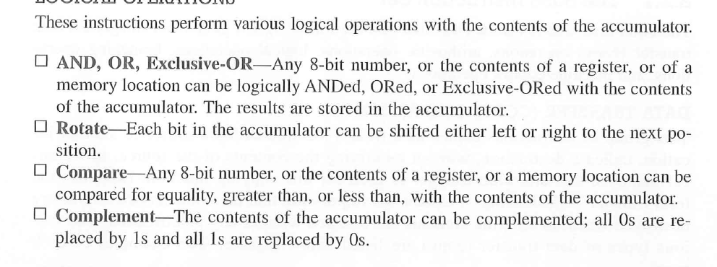
Logical Operation

Slide 15
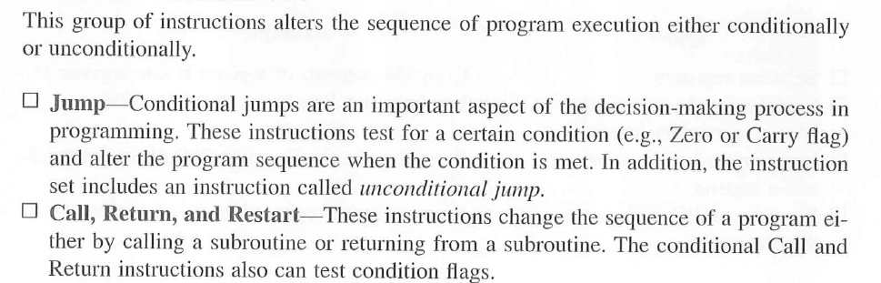
Branching operation

Slide 16
Machine control operation
Control machine function such as Halt,Interrupt.

Slide 17
Instruction
Is a command to the microprocessor to perform a given task on specified data.
Each instruction has two parts
One is the task to be performed called operational code(op-code)
Data to be operated on called operand
May include 8 or 16 bite data ,an internal register ,a memory location.

Slide 18
Instruction Word Size
1-Byte instruction
2-Byte instruction
3-Byte instruction

Slide 19
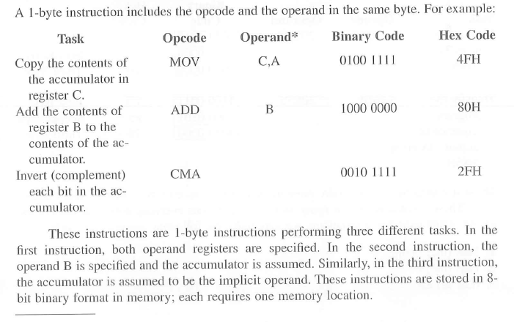
1 byte instruction

Slide 20
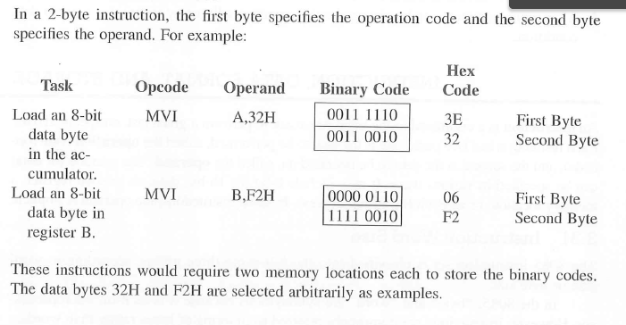
2-byte instruction

Slide 21
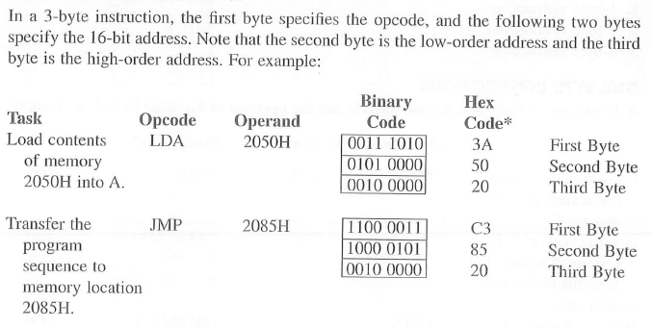
3-byte instruction

